Slide 1
CLOUD BASED EVENT TABULATION SYSTEM

Slide 2
TABLE OF CONTENTS
01
04
Our Team
Major Requirements
02
05
About The Project
Project Goals
03
06
Conceptual Framework
Our Timeline

Slide 3

OUR TEAM
TEAM RAMA
"Alone we can do so little; together we can do so much." – Helen Keller
Whether we play a large or small role, by working together everyone achieves more. We work as a team, because Peace is our Dream. Teamwork means not having to take all the blame, together we grow. we achieve our goal. We play together, we win together; We lose together, We stay together.

Slide 4
THE RESEARCHERS
Ronell M. Picaña
Angeline S. Acutillar
Merson L. Taguiam
Aljune S. Aguilar
QA TESTER
QA TESTER
PROJECT MANAGER
QA TESTER
TECHNICAL WRITER
TECHNICAL WRITER
DATABASE DEVELOPER
SYSTEM ANALYST
SYSTEM ANALYST
SYSTEM ANALYST
SOFWARE DEVELOPER
NETWORK DESIGNER
Mr. William Aldana
Thesis Adviser
San Jose City, Nueva Ecija
Science City of Muñoz, Nueva Ecija
Rizal, Nueva Ecija
San Jose City Nueva Ecija

Slide 5
ABOUT THE PROJECT
Cloud Based Event Tabulation System is designed and developed specifically to cope up with the pandemic crisis people facing right now. The researchers will make it possible to conduct a contactless event tabulation which can cast votes and scores online.

Slide 6
What is the Cloud Based Event Tabulation System?
The study is a combined two systems, an electronic voting system and pageant tabulation system.
It is built, hosted and delivered via a cloud computing platform via the internet, and can be accessed remotely.
It is web application that is more secure, fast, user-friendly, and can produce a reliable and accurate results to prevent human error.

Slide 7
PAGEANT TABULATION SYSTEM
RESPONSIVE DESIGN
DYNAMIC/FLEXIBLE
SECURED
INSTALLED CAMERA
CLOUD WEB HOSTING

Slide 8
ELECTRONIC VOTING SYSTEM
RESPONSIVE DESIGN
FLEXIBLE/DYNAMIC
SECURED
LIVE RESULTS
CLOUD WEB HOSTING

Slide 9
THE GENERAL OBJECTIVES
To ensure a fast and secure of casting votes.
To allow a contactless event.
Provide a user-friendly interface for the users to access.
To enumerate the challenges encountered with the existing system.
To identify the accuracy of the system.
To identify the advantage of having a well-developed tabulating system.

Slide 10
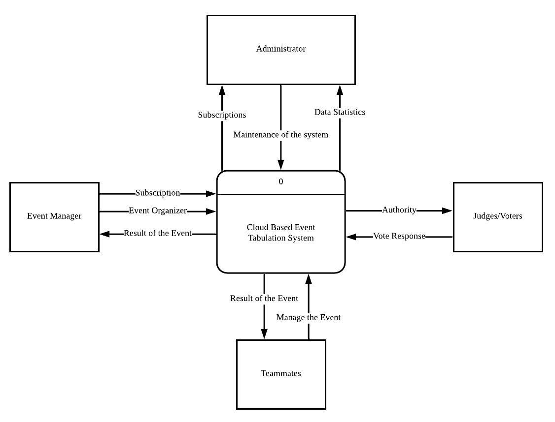
CONCEPTUAL FRAMEWORK
Administrator
Event Manager
Teammates
Judges/Voters
The administrator has owned and who can manage the whole cycle of the system, the responsible for maintaining of the system.
The main beneficiary of this study, the responsible of the event created such as Tabulation or for the election.
The teammates were can able to manage voting system or tabulation system which depend to event manager what set the account restrictions if the account can access or not for the event created.
The judges and voters, who’s giving vote response to system.

Slide 11





MAJOR REQUIREMENTS
XAMPP
VISUAL STUDIO CODE
BOOTSTRAP
LARAVEL
VUE JS
XAMPP is an abbreviation for cross-platform, Apache, MySQL, PHP and Perl
It is a streamlined code editor with support for development operations like debugging, task running, and version control
Laravel is a free, open-source PHP web framework, created by Taylor Otwel
Bootstrap is a free front-end framework for faster and easier web development.
Vue.js is an open-source model–view–viewmodel front end JavaScript framework for building user interfaces and single-page applications

Slide 12
WHAT WE ARE WORKING ON
SECURITY
RELIABILITY
FLEXIBILITY
ACCURACY
USABILITY
The quality or state of being secure, free from danger, freedom from fear or anxiety.
The quality or state of being correct or precise.
The consistently good in quality or performance and able to be trusted.
To provide a condition for its users to perform the tasks safely, effectively, and efficiently
The ability to be easily modified and willingness to change or compromise

Slide 13
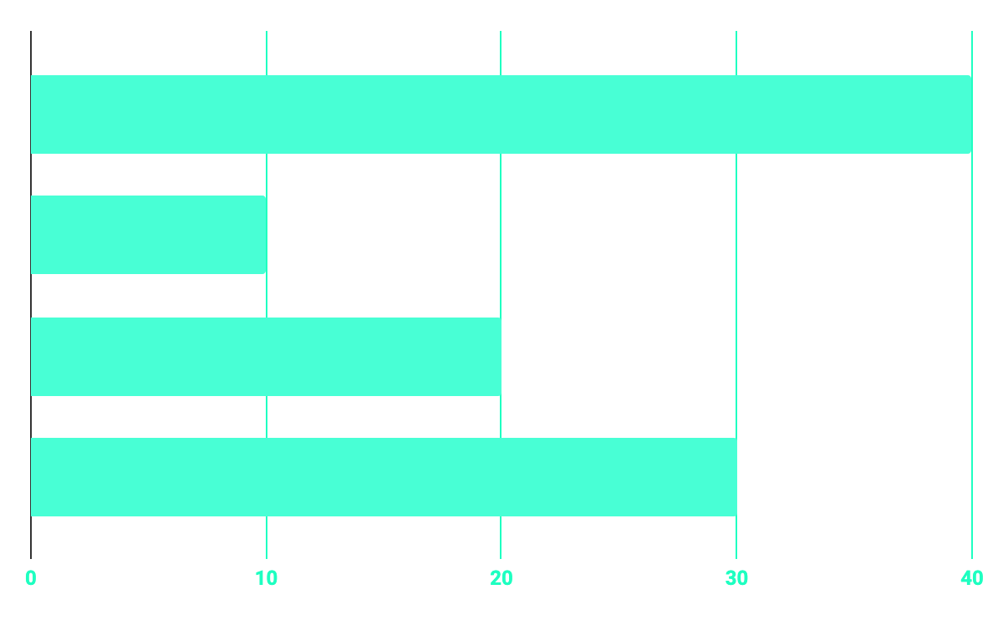
TIME MANAGEMENT
40%
20%
PROGRAMMING
10%
30%
DATABASE
WEB DESIGN
UX/UI RESEARCH

Slide 14
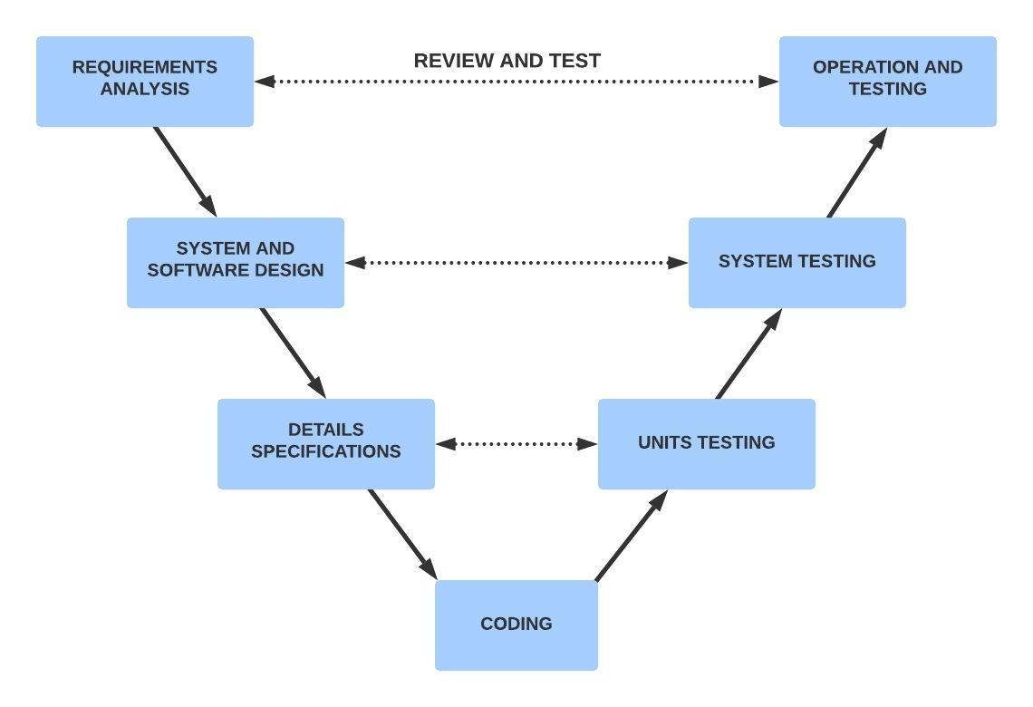
OUR GOALS
REQUIREMENTS ANALYSIS
SYSTEM AND SOFTWARE DESIGN
DETAILS SPECIFICATIONS
CODING
UNITS TESTING
SYSTEM TESTING
OPERATION AND TESTING
VERIFICATION AND VALIDATION

Slide 15
ESTIMATED TIMELINE
PLANNING PHASE
ANALYSIS PHASE
CODING/DESIGN PHASE
Task | OCTOBER |  |  |  | NOVEMBER |  |  |  |  | DECEMBER |  |  |  | JANUARY
 | 2020 |  |  |  | 2020 |  |  |  |  | 2020 |  |  |  | 2021
PLANNING PHASE
ANALYSIS PHASE
DESIGN PHASE
TESTING PHASE
IMPLEMENTATION PHASE
MAINTENANCE PHASE
TESTING PHASE
IMPLEMENTATION PHASE
MAINTENANCE PHASE

Slide 16
PROJECT STAGES
Teamwork - a group of interdependent that individuals who work together.
Teamwork - to collaborative effort of a group to achieve a common goal or to complete a task.
Teamwork - the most effective and efficient way to finish the capstone project.

Slide 17
THANK YOU!

